Slide 1
Homework #3 Discussion
Python/Pyomo Implementation - trends observed

Slide 2
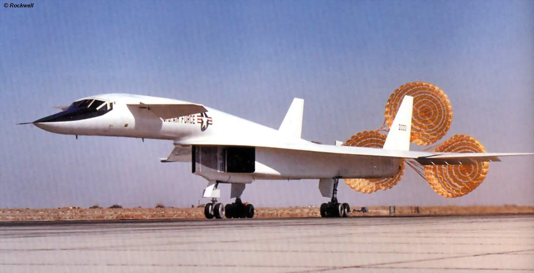

Slide 3
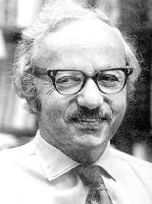
OPER 610 Lesson 05 The Simplex Method: Key Concepts (Revisited)
Dr Brian J. Lunday
Office: Rm 201E, Bldg 641

Slide 4


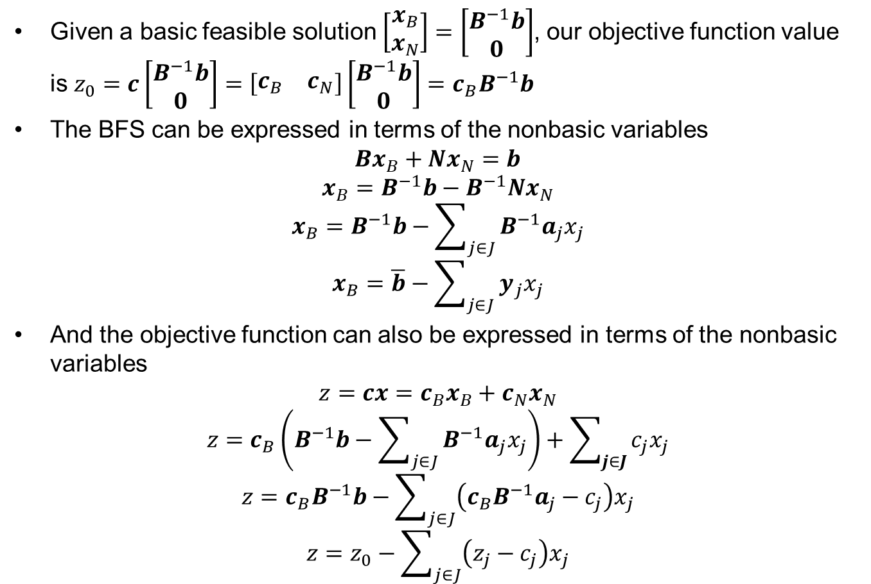


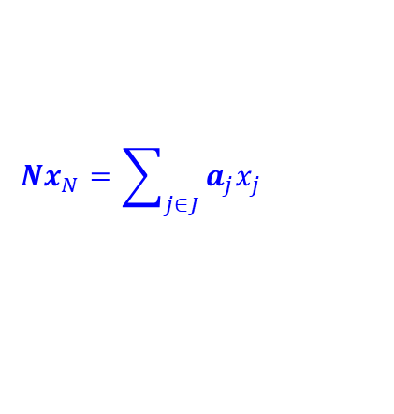
The Key to the Simplex Method! (1 of 2)
Given a basic feasible solution $\left[\begin{matrix}x_{B} \\ x_{N}\end{matrix}\right]=\left[\begin{matrix}B^{−1}b \\ 0\end{matrix}\right]$, our objective function value is $z_{0}=c\left[\begin{matrix}B^{−1}b \\ 0\end{matrix}\right]=\left[\begin{matrix}c_{B} & c_{N}\end{matrix}\right]\left[\begin{matrix}B^{−1}b \\ 0\end{matrix}\right]=c_{B}B^{−1}b$
The BFS can be expressed in terms of the nonbasic variables
$$Bx_{B}+Nx_{N}=b$$
$$x_{B}=B^{−1}b−B^{−1}Nx_{N}$$
$$x_{B}=B^{−1}b−\sum_{j∈J}{B^{−1}a_{j}x_{j}}$$
$$x_{B}=\overline{b}−\sum_{j∈J}{y_{j}x_{j}}$$
And the objective function can also be expressed in terms of the nonbasic variables
$$z=cx=c_{B}x_{B}+c_{N}x_{N}$$
$$z=c_{B}\left(B^{−1}b−\sum_{j∈J}{B^{−1}a_{j}x_{j}}\right)+\sum_{j∈J}{c_{j}x_{j}}$$
$$z=c_{B}B^{−1}b−\sum_{j∈J}{\left({c_{B}B}^{−1}a_{j}−c_{j}\right)x_{j}}$$
$$z=z_{0}−\sum_{j∈J}{\left(z_{j}−c_{j}\right)x_{j}}$$
$$Nx_{N}=\sum_{j∈J}{a_{j}x_{j}}$$
$$B^{−1}a_{j}=y_{j}$$
What happens to $xB$ as an $x_{j}↑$?
$$z_{j}={c_{B}B}^{−1}a_{j}$$
What happens to $z$ as an $x_{j}↑$?

Slide 5
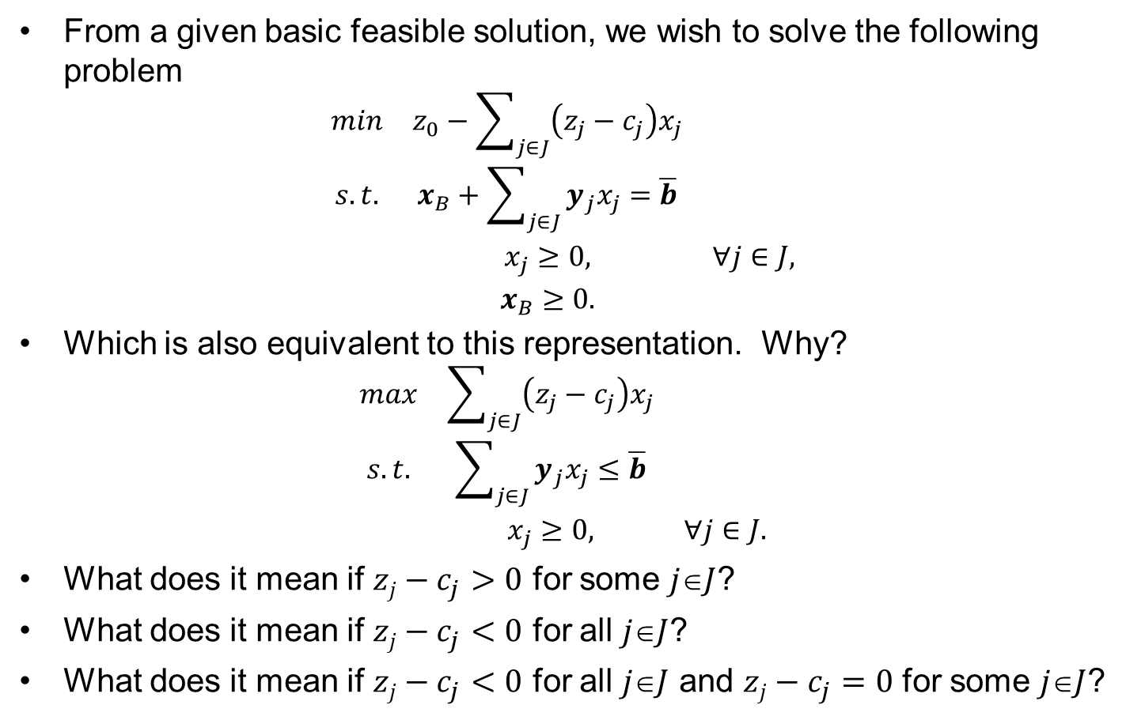
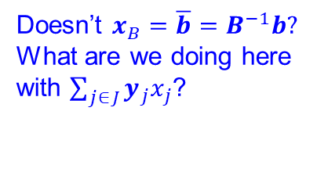
The Key to the Simplex Method! (2 of 2)
From a given basic feasible solution, we wish to solve the following problem
$$\begin{matrix}min & z_{0}−\sum_{j∈J}{\left(z_{j}−c_{j}\right)x_{j}} & \\ s.t. & x_{B}+\sum_{j∈J}{y_{j}x_{j}}=\overline{b} & \\ & x_{j}≥0, & ∀j∈J, \\ & x_{B}≥0. & \end{matrix}$$
Which is also equivalent to this representation. Why?
$$\begin{matrix}max & \sum_{j∈J}{\left(z_{j}−c_{j}\right)x_{j}} & \\ s.t. & \sum_{j∈J}{y_{j}x_{j}}≤\overline{b} & \\ & x_{j}≥0, & ∀j∈J.\end{matrix}$$
What does it mean if $zj−c_{j}>0$ for some $jJ$?
What does it mean if $zj−c_{j}<0$ for all $jJ$?
What does it mean if $zj−c_{j}<0$ for all $jJ$ and $zj−c_{j}=0$ for some $jJ$?
Doesn’t $x_{B}=\overline{b}=B^{−1}b?$ What are we doing here with $\sum_{j∈J}{y_{j}x_{j}}$?

Slide 6
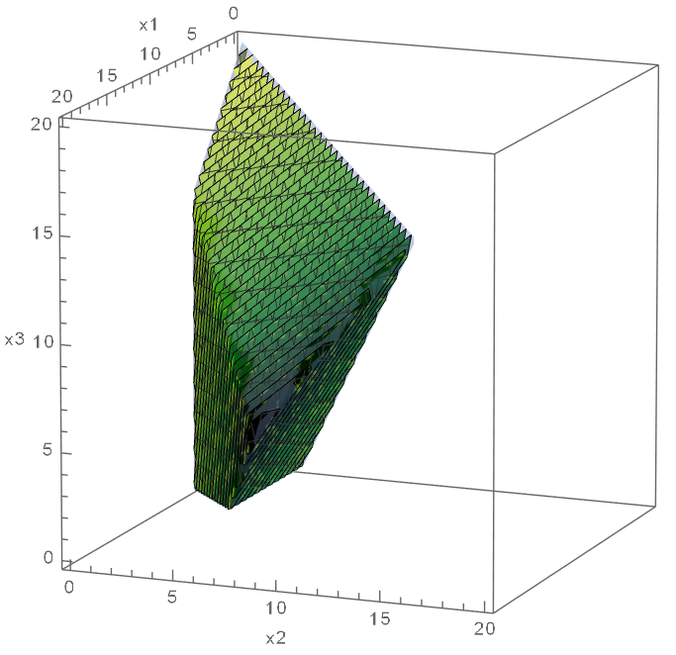

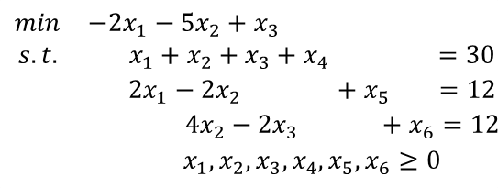

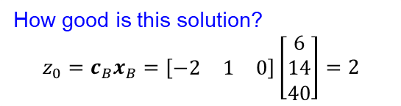
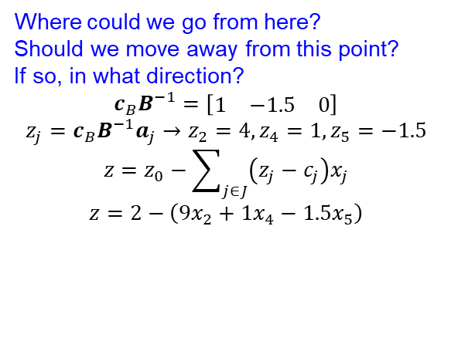
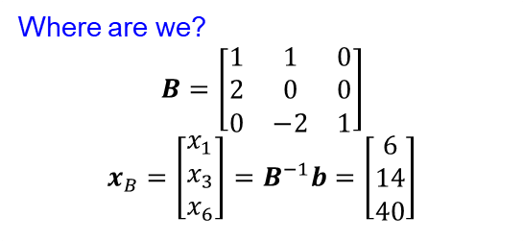
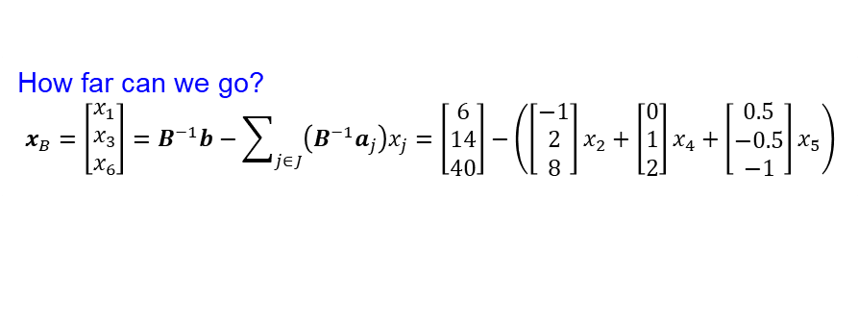

Algebra of the Simplex Method
$$\begin{matrix}min & −2x_{1}−5x_{2}+x_{3} \\ s.t. & x_{1}+x_{2}+x_{3}+x_{4} =30 \\ & 2x_{1}−2x_{2} +x_{5} =12 \\ & 4x_{2}−2x_{3} +x_{6}=12 \\ & x_{1},x_{2},x_{3},x_{4},x_{5},x_{6}≥0\end{matrix}$$
$$x_{5}↑$$
Where are we?
$$B=\left[\begin{matrix}1 & 1 & 0 \\ 2 & 0 & 0 \\ 0 & −2 & 1\end{matrix}\right]$$
$$x_{B}=\left[\begin{matrix}x_{1} \\ x_{3} \\ x_{6}\end{matrix}\right]=B^{−1}b=\left[\begin{matrix}6 \\ 14 \\ 40\end{matrix}\right]$$
$$x_{4}↑$$
$$x_{2}↑$$
How good is this solution?
$$z_{0}=c_{B}x_{B}=\left[\begin{matrix}−2 & 1 & 0\end{matrix}\right]\left[\begin{matrix}6 \\ 14 \\ 40\end{matrix}\right]=2$$
Where could we go from here?
Should we move away from this point?
If so, in what direction?
$$c_{B}B^{−1}=\left[\begin{matrix}1 & −1.5 & 0\end{matrix}\right]$$
$$z_{j}=c_{B}B^{−1}a_{j}→z_{2}=4,z_{4}=1,z_{5}=−1.5$$
$$z=z_{0}−\sum_{j∈J}{\left(z_{j}−c_{j}\right)x_{j}}$$
$$z=2−\left(9x_{2}+1x_{4}−1.5x_{5}\right)$$
How far can we go?
$$x_{B}=\left[\begin{matrix}x_{1} \\ x_{3} \\ x_{6}\end{matrix}\right]=B^{−1}b−\sum_{j∈J}{\left(B^{−1}a_{j}\right)x_{j}}=\left[\begin{matrix}6 \\ 14 \\ 40\end{matrix}\right]−\left(\left[\begin{matrix}−1 \\ 2 \\ 8\end{matrix}\right]x_{2}+\left[\begin{matrix}0 \\ 1 \\ 2\end{matrix}\right]x_{4}+\left[\begin{matrix}0.5 \\ −0.5 \\ −1\end{matrix}\right]x_{5}\right)$$

Slide 7
OPER 610 Lesson 06 The Simplex Method: Algebraic and Tableau Implementations
Dr Brian J. Lunday
Office: Rm 201E, Bldg 641

Slide 8
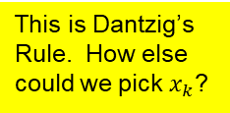
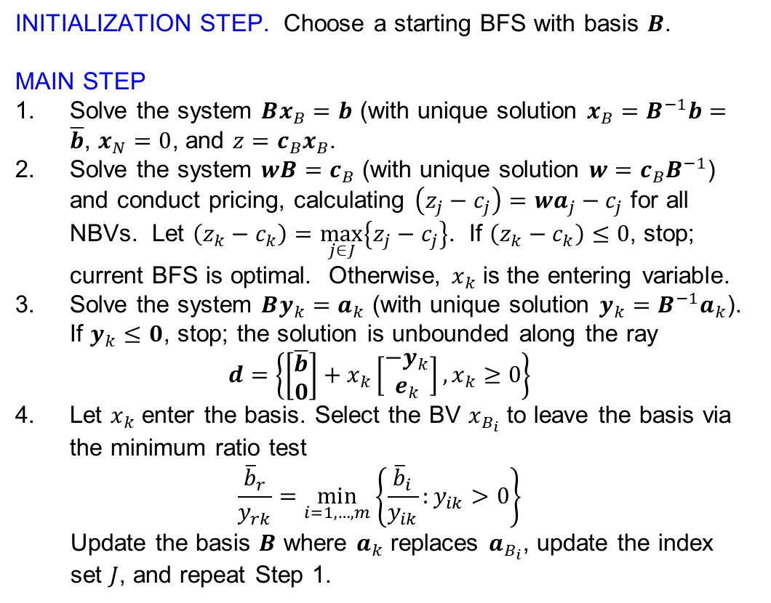
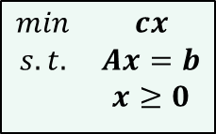
The Simplex Algorithm
$$\begin{matrix}min & cx \\ s.t. & Ax=b \\ & x≥0\end{matrix}$$
INITIALIZATION STEP. Choose a starting BFS with basis $B$.
MAIN STEP
Solve the system $Bx_{B}=b$ (with unique solution $x_{B}=B^{−1}b=\overline{b}$, $x_{N}=0$, and $z=c_{B}x_{B}$.
Solve the system $wB=c_{B}$ (with unique solution $w=c_{B}B^{−1}$) and conduct pricing, calculating $\left(z_{j}−c_{j}\right)=wa_{j}−c_{j}$ for all NBVs. Let $\left(z_{k}−c_{k}\right)=\max_{j∈J}\left\{z_{j}−c_{j}\right\}$. If $\left(z_{k}−c_{k}\right)≤0$, stop; current BFS is optimal. Otherwise, $x_{k}$ is the entering variable.
Solve the system $By_{k}=a_{k}$ (with unique solution $y_{k}=B^{−1}a_{k}$). If $y_{k}≤0$, stop; the solution is unbounded along the ray
$$d=\left\{\left[\begin{matrix}\overline{b} \\ 0\end{matrix}\right]+x_{k}\left[\begin{matrix}−y_{k} \\ e_{k}\end{matrix}\right],x_{k}≥0\right\}$$
Let $x_{k}$ enter the basis. Select the BV $x_{B_{i}}$ to leave the basis via the minimum ratio test
$$\frac{{\overline{b}}_{r}}{y_{rk}}=\min_{i=1,…,m}\left\{\frac{{\overline{b}}_{i}}{y_{ik}}:y_{ik}>0\right\}$$
Update the basis $B$ where $a_{k}$ replaces $a_{B_{i}}$, update the index set $J$, and repeat Step 1.
This is Dantzig’s Rule. How else could we pick $x_{k}$?

Slide 9
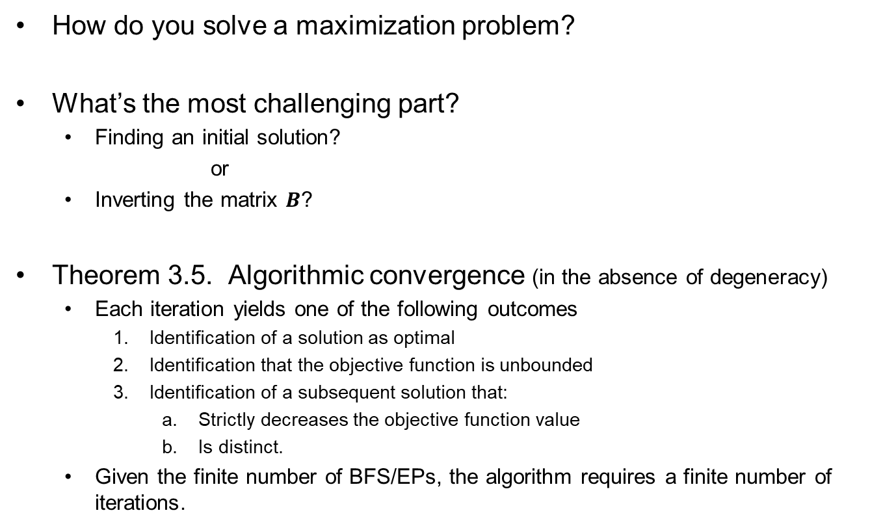
Simplex Algorithm Notes
How do you solve a maximization problem?
What’s the most challenging part?
Finding an initial solution?
or
Inverting the matrix $B$?
Theorem 3.5. Algorithmic convergence (in the absence of degeneracy)
Each iteration yields one of the following outcomes
Identification of a solution as optimal
Identification that the objective function is unbounded
Identification of a subsequent solution that:
Strictly decreases the objective function value
Is distinct.
Given the finite number of BFS/EPs, the algorithm requires a finite number of iterations.

Slide 10
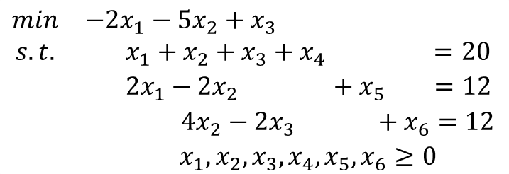
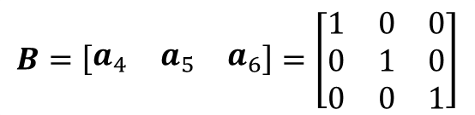
Example of the Simplex Algorithm in Algebraic Format (Initialization)
Problem P
$$\begin{matrix}min & −2x_{1}−5x_{2}+x_{3} \\ s.t. & x_{1}+x_{2}+x_{3}+x_{4} =20 \\ & 2x_{1}−2x_{2} +x_{5} =12 \\ & 4x_{2}−2x_{3} +x_{6}=12 \\ & x_{1},x_{2},x_{3},x_{4},x_{5},x_{6}≥0\end{matrix}$$
INTIALIZATION STEP
$$B=\left[\begin{matrix}a_{4} & a_{5} & a_{6}\end{matrix}\right]=\left[\begin{matrix}1 & 0 & 0 \\ 0 & 1 & 0 \\ 0 & 0 & 1\end{matrix}\right]$$

Slide 11
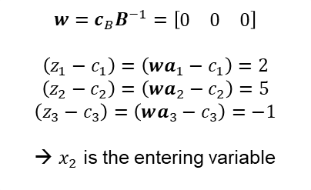
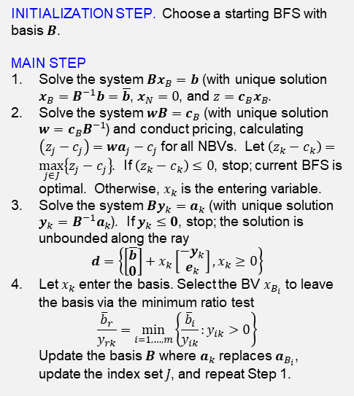
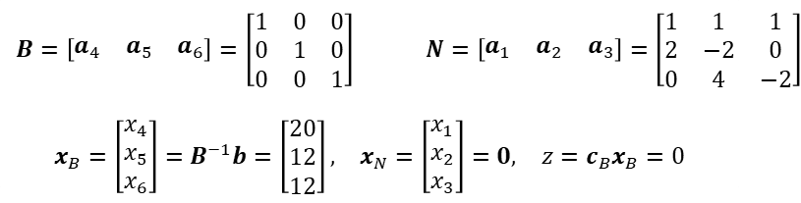
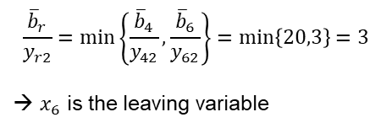
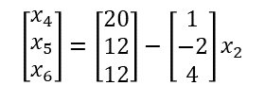
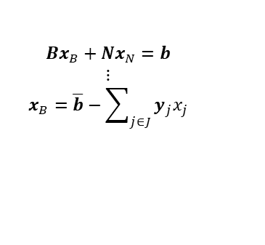
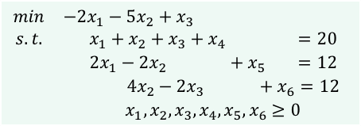
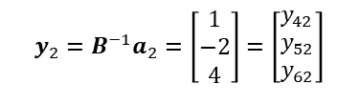
Example of the Simplex Algorithm in Algebraic Format (Iteration #1)
Step 1
$$\begin{matrix}min & −2x_{1}−5x_{2}+x_{3} \\ s.t. & x_{1}+x_{2}+x_{3}+x_{4} =20 \\ & 2x_{1}−2x_{2} +x_{5} =12 \\ & 4x_{2}−2x_{3} +x_{6}=12 \\ & x_{1},x_{2},x_{3},x_{4},x_{5},x_{6}≥0\end{matrix}$$
$$\begin{matrix}B=\left[\begin{matrix}a_{4} & a_{5} & a_{6}\end{matrix}\right]=\left[\begin{matrix}1 & 0 & 0 \\ 0 & 1 & 0 \\ 0 & 0 & 1\end{matrix}\right] & & N=\left[\begin{matrix}a_{1} & a_{2} & a_{3}\end{matrix}\right]=\left[\begin{matrix}1 & 1 & 1 \\ 2 & −2 & 0 \\ 0 & 4 & −2\end{matrix}\right]\end{matrix}$$
$$\begin{matrix}x_{B}=\left[\begin{matrix}x_{4} \\ x_{5} \\ x_{6}\end{matrix}\right]=B^{−1}b=\left[\begin{matrix}20 \\ 12 \\ 12\end{matrix}\right], & x_{N}=\left[\begin{matrix}x_{1} \\ x_{2} \\ x_{3}\end{matrix}\right]=0, & z=c_{B}x_{B}=0\end{matrix}$$
INITIALIZATION STEP. Choose a starting BFS with basis $B$.
MAIN STEP
Solve the system $Bx_{B}=b$ (with unique solution $x_{B}=B^{−1}b=\overline{b}$, $x_{N}=0$, and $z=c_{B}x_{B}$.
Solve the system $wB=c_{B}$ (with unique solution $w=c_{B}B^{−1}$) and conduct pricing, calculating $\left(z_{j}−c_{j}\right)=wa_{j}−c_{j}$ for all NBVs. Let $\left(z_{k}−c_{k}\right)=\max_{j∈J}\left\{z_{j}−c_{j}\right\}$. If $\left(z_{k}−c_{k}\right)≤0$, stop; current BFS is optimal. Otherwise, $x_{k}$ is the entering variable.
Solve the system $By_{k}=a_{k}$ (with unique solution $y_{k}=B^{−1}a_{k}$). If $y_{k}≤0$, stop; the solution is unbounded along the ray
$$d=\left\{\left[\begin{matrix}\overline{b} \\ 0\end{matrix}\right]+x_{k}\left[\begin{matrix}−y_{k} \\ e_{k}\end{matrix}\right],x_{k}≥0\right\}$$
Let $x_{k}$ enter the basis. Select the BV $x_{B_{i}}$ to leave the basis via the minimum ratio test
$$\frac{{\overline{b}}_{r}}{y_{rk}}=\min_{i=1,…,m}\left\{\frac{{\overline{b}}_{i}}{y_{ik}}:y_{ik}>0\right\}$$
Update the basis $B$ where $a_{k}$ replaces $a_{B_{i}}$, update the index set $J$, and repeat Step 1.
Step 2
$$w=c_{B}B^{−1}=\left[\begin{matrix}0 & 0 & 0\end{matrix}\right]$$
$$\left(z_{1}−c_{1}\right)=\left(wa_{1}−c_{1}\right)=2$$
$$\left(z_{2}−c_{2}\right)=\left(wa_{2}−c_{2}\right)=5$$
$$\left(z_{3}−c_{3}\right)=\left(wa_{3}−c_{3}\right)=−1$$
→ $x_{2}$ is the entering variable
Step 3
$$y_{2}=B^{−1}a_{2}=\left[\begin{matrix}1 \\ −2 \\ 4\end{matrix}\right]=\left[\begin{matrix}y_{42} \\ y_{52} \\ y_{62}\end{matrix}\right]$$
Step 4
$$\frac{{\overline{b}}_{r}}{y_{r2}}=\min\left\{\frac{{\overline{b}}_{4}}{y_{42}},\frac{{\overline{b}}_{6}}{y_{62}}\right\}=\min\left\{20,3\right\}=3$$
→ $x_{6}$ is the leaving variable
$$\left[\begin{matrix}x_{4} \\ x_{5} \\ x_{6}\end{matrix}\right]=\left[\begin{matrix}20 \\ 12 \\ 12\end{matrix}\right]−\left[\begin{matrix}1 \\ −2 \\ 4\end{matrix}\right]x_{2}$$
$$Bx_{B}+Nx_{N}=b$$
$$⋮$$
$$x_{B}=\overline{b}−\sum_{j∈J}{y_{j}x_{j}}$$

Slide 12
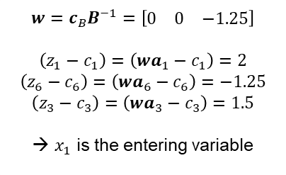

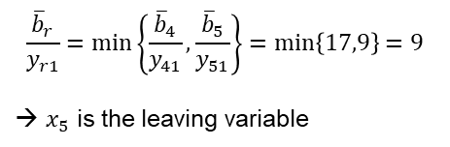
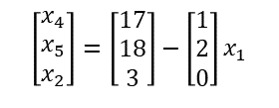
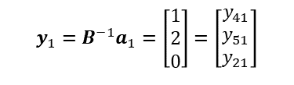
Example of the Simplex Algorithm in Algebraic Format (Iteration #2)
Step 1
$$\begin{matrix}min & −2x_{1}−5x_{2}+x_{3} \\ s.t. & x_{1}+x_{2}+x_{3}+x_{4} =20 \\ & 2x_{1}−2x_{2} +x_{5} =12 \\ & 4x_{2}−2x_{3} +x_{6}=12 \\ & x_{1},x_{2},x_{3},x_{4},x_{5},x_{6}≥0\end{matrix}$$
$$\begin{matrix}B=\left[\begin{matrix}a_{4} & a_{5} & a_{2}\end{matrix}\right]=\left[\begin{matrix}1 & 0 & 1 \\ 0 & 1 & −2 \\ 0 & 0 & 4\end{matrix}\right] & & N=\left[\begin{matrix}a_{1} & a_{6} & a_{3}\end{matrix}\right]=\left[\begin{matrix}1 & 0 & 1 \\ 2 & 0 & 0 \\ 0 & 1 & −2\end{matrix}\right]\end{matrix}$$
$$\begin{matrix}x_{B}=\left[\begin{matrix}x_{4} \\ x_{5} \\ x_{2}\end{matrix}\right]=B^{−1}b=\left[\begin{matrix}17 \\ 18 \\ 3\end{matrix}\right], & x_{N}=\left[\begin{matrix}x_{1} \\ x_{6} \\ x_{3}\end{matrix}\right]=0, & z=c_{B}x_{B}=−15\end{matrix}$$
INITIALIZATION STEP. Choose a starting BFS with basis $B$.
MAIN STEP
Solve the system $Bx_{B}=b$ (with unique solution $x_{B}=B^{−1}b=\overline{b}$, $x_{N}=0$, and $z=c_{B}x_{B}$.
Solve the system $wB=c_{B}$ (with unique solution $w=c_{B}B^{−1}$) and conduct pricing, calculating $\left(z_{j}−c_{j}\right)=wa_{j}−c_{j}$ for all NBVs. Let $\left(z_{k}−c_{k}\right)=\max_{j∈J}\left\{z_{j}−c_{j}\right\}$. If $\left(z_{k}−c_{k}\right)≤0$, stop; current BFS is optimal. Otherwise, $x_{k}$ is the entering variable.
Solve the system $By_{k}=a_{k}$ (with unique solution $y_{k}=B^{−1}a_{k}$). If $y_{k}≤0$, stop; the solution is unbounded along the ray
$$d=\left\{\left[\begin{matrix}\overline{b} \\ 0\end{matrix}\right]+x_{k}\left[\begin{matrix}−y_{k} \\ e_{k}\end{matrix}\right],x_{k}≥0\right\}$$
Let $x_{k}$ enter the basis. Select the BV $x_{B_{i}}$ to leave the basis via the minimum ratio test
$$\frac{{\overline{b}}_{r}}{y_{rk}}=\min_{i=1,…,m}\left\{\frac{{\overline{b}}_{i}}{y_{ik}}:y_{ik}>0\right\}$$
Update the basis $B$ where $a_{k}$ replaces $a_{B_{i}}$, update the index set $J$, and repeat Step 1.
Step 2
$$w=c_{B}B^{−1}=\left[\begin{matrix}0 & 0 & −1.25\end{matrix}\right]$$
$$\left(z_{1}−c_{1}\right)=\left(wa_{1}−c_{1}\right)=2$$
$$\left(z_{6}−c_{6}\right)=\left(wa_{6}−c_{6}\right)=−1.25$$
$$\left(z_{3}−c_{3}\right)=\left(wa_{3}−c_{3}\right)=1.5$$
→ $x_{1}$ is the entering variable
Step 3
$$y_{1}=B^{−1}a_{1}=\left[\begin{matrix}1 \\ 2 \\ 0\end{matrix}\right]=\left[\begin{matrix}y_{41} \\ y_{51} \\ y_{21}\end{matrix}\right]$$
Step 4
$$\frac{{\overline{b}}_{r}}{y_{r1}}=\min\left\{\frac{{\overline{b}}_{4}}{y_{41}},\frac{{\overline{b}}_{5}}{y_{51}}\right\}=\min\left\{17,9\right\}=9$$
→ $x_{5}$ is the leaving variable
$$\left[\begin{matrix}x_{4} \\ x_{5} \\ x_{2}\end{matrix}\right]=\left[\begin{matrix}17 \\ 18 \\ 3\end{matrix}\right]−\left[\begin{matrix}1 \\ 2 \\ 0\end{matrix}\right]x_{1}$$
$$Bx_{B}+Nx_{N}=b$$
$$⋮$$
$$x_{B}=\overline{b}−\sum_{j∈J}{y_{j}x_{j}}$$

Slide 13
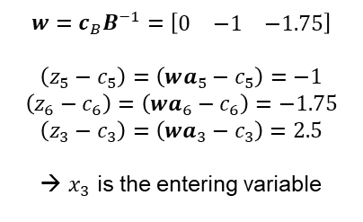
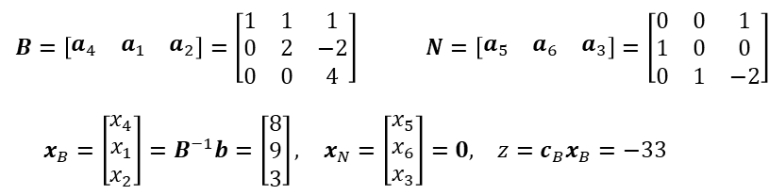
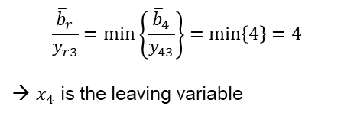
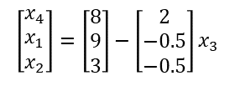
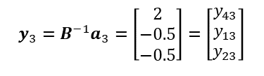
Example of the Simplex Algorithm in Algebraic Format (Iteration #3)
Step 1
$$\begin{matrix}min & −2x_{1}−5x_{2}+x_{3} \\ s.t. & x_{1}+x_{2}+x_{3}+x_{4} =20 \\ & 2x_{1}−2x_{2} +x_{5} =12 \\ & 4x_{2}−2x_{3} +x_{6}=12 \\ & x_{1},x_{2},x_{3},x_{4},x_{5},x_{6}≥0\end{matrix}$$
$$\begin{matrix}B=\left[\begin{matrix}a_{4} & a_{1} & a_{2}\end{matrix}\right]=\left[\begin{matrix}1 & 1 & 1 \\ 0 & 2 & −2 \\ 0 & 0 & 4\end{matrix}\right] & & N=\left[\begin{matrix}a_{5} & a_{6} & a_{3}\end{matrix}\right]=\left[\begin{matrix}0 & 0 & 1 \\ 1 & 0 & 0 \\ 0 & 1 & −2\end{matrix}\right]\end{matrix}$$
$$\begin{matrix}x_{B}=\left[\begin{matrix}x_{4} \\ x_{1} \\ x_{2}\end{matrix}\right]=B^{−1}b=\left[\begin{matrix}8 \\ 9 \\ 3\end{matrix}\right], & x_{N}=\left[\begin{matrix}x_{5} \\ x_{6} \\ x_{3}\end{matrix}\right]=0, & z=c_{B}x_{B}=−33\end{matrix}$$
INITIALIZATION STEP. Choose a starting BFS with basis $B$.
MAIN STEP
Solve the system $Bx_{B}=b$ (with unique solution $x_{B}=B^{−1}b=\overline{b}$, $x_{N}=0$, and $z=c_{B}x_{B}$.
Solve the system $wB=c_{B}$ (with unique solution $w=c_{B}B^{−1}$) and conduct pricing, calculating $\left(z_{j}−c_{j}\right)=wa_{j}−c_{j}$ for all NBVs. Let $\left(z_{k}−c_{k}\right)=\max_{j∈J}\left\{z_{j}−c_{j}\right\}$. If $\left(z_{k}−c_{k}\right)≤0$, stop; current BFS is optimal. Otherwise, $x_{k}$ is the entering variable.
Solve the system $By_{k}=a_{k}$ (with unique solution $y_{k}=B^{−1}a_{k}$). If $y_{k}≤0$, stop; the solution is unbounded along the ray
$$d=\left\{\left[\begin{matrix}\overline{b} \\ 0\end{matrix}\right]+x_{k}\left[\begin{matrix}−y_{k} \\ e_{k}\end{matrix}\right],x_{k}≥0\right\}$$
Let $x_{k}$ enter the basis. Select the BV $x_{B_{i}}$ to leave the basis via the minimum ratio test
$$\frac{{\overline{b}}_{r}}{y_{rk}}=\min_{i=1,…,m}\left\{\frac{{\overline{b}}_{i}}{y_{ik}}:y_{ik}>0\right\}$$
Update the basis $B$ where $a_{k}$ replaces $a_{B_{i}}$, update the index set $J$, and repeat Step 1.
Step 2
$$w=c_{B}B^{−1}=\left[\begin{matrix}0 & −1 & −1.75\end{matrix}\right]$$
$$\left(z_{5}−c_{5}\right)=\left(wa_{5}−c_{5}\right)=−1$$
$$\left(z_{6}−c_{6}\right)=\left(wa_{6}−c_{6}\right)=−1.75$$
$$\left(z_{3}−c_{3}\right)=\left(wa_{3}−c_{3}\right)=2.5$$
→ $x_{3}$ is the entering variable
Step 3
$$y_{3}=B^{−1}a_{3}=\left[\begin{matrix}2 \\ −0.5 \\ −0.5\end{matrix}\right]=\left[\begin{matrix}y_{43} \\ y_{13} \\ y_{23}\end{matrix}\right]$$
Step 4
$$\frac{{\overline{b}}_{r}}{y_{r3}}=\min\left\{\frac{{\overline{b}}_{4}}{y_{43}}\right\}=\min\left\{4\right\}=4$$
→ $x_{4}$ is the leaving variable
$$\left[\begin{matrix}x_{4} \\ x_{1} \\ x_{2}\end{matrix}\right]=\left[\begin{matrix}8 \\ 9 \\ 3\end{matrix}\right]−\left[\begin{matrix}2 \\ −0.5 \\ −0.5\end{matrix}\right]x_{3}$$
$$Bx_{B}+Nx_{N}=b$$
$$⋮$$
$$x_{B}=\overline{b}−\sum_{j∈J}{y_{j}x_{j}}$$

Slide 14
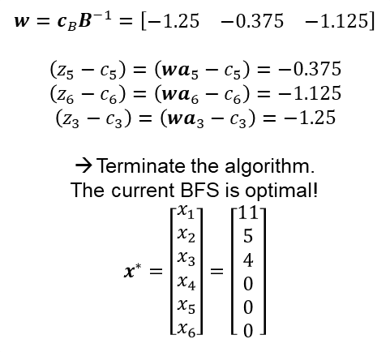

Example of the Simplex Algorithm in Algebraic Format (Iteration #4)
Step 1
$$\begin{matrix}min & −2x_{1}−5x_{2}+x_{3} \\ s.t. & x_{1}+x_{2}+x_{3}+x_{4} =20 \\ & 2x_{1}−2x_{2} +x_{5} =12 \\ & 4x_{2}−2x_{3} +x_{6}=12 \\ & x_{1},x_{2},x_{3},x_{4},x_{5},x_{6}≥0\end{matrix}$$
$$\begin{matrix}B=\left[\begin{matrix}a_{3} & a_{1} & a_{2}\end{matrix}\right]=\left[\begin{matrix}1 & 1 & 1 \\ 0 & 2 & −2 \\ −2 & 0 & 4\end{matrix}\right] & & N=\left[\begin{matrix}a_{5} & a_{6} & a_{4}\end{matrix}\right]=\left[\begin{matrix}0 & 0 & 1 \\ 1 & 0 & 0 \\ 0 & 1 & 0\end{matrix}\right]\end{matrix}$$
$$\begin{matrix}x_{B}=\left[\begin{matrix}x_{3} \\ x_{1} \\ x_{2}\end{matrix}\right]=B^{−1}b=\left[\begin{matrix}4 \\ 11 \\ 5\end{matrix}\right], & x_{N}=\left[\begin{matrix}x_{5} \\ x_{6} \\ x_{4}\end{matrix}\right]=0, & z=c_{B}x_{B}=−43\end{matrix}$$
INITIALIZATION STEP. Choose a starting BFS with basis $B$.
MAIN STEP
Solve the system $Bx_{B}=b$ (with unique solution $x_{B}=B^{−1}b=\overline{b}$, $x_{N}=0$, and $z=c_{B}x_{B}$.
Solve the system $wB=c_{B}$ (with unique solution $w=c_{B}B^{−1}$) and conduct pricing, calculating $\left(z_{j}−c_{j}\right)=wa_{j}−c_{j}$ for all NBVs. Let $\left(z_{k}−c_{k}\right)=\max_{j∈J}\left\{z_{j}−c_{j}\right\}$. If $\left(z_{k}−c_{k}\right)≤0$, stop; current BFS is optimal. Otherwise, $x_{k}$ is the entering variable.
Solve the system $By_{k}=a_{k}$ (with unique solution $y_{k}=B^{−1}a_{k}$). If $y_{k}≤0$, stop; the solution is unbounded along the ray
$$d=\left\{\left[\begin{matrix}\overline{b} \\ 0\end{matrix}\right]+x_{k}\left[\begin{matrix}−y_{k} \\ e_{k}\end{matrix}\right],x_{k}≥0\right\}$$
Let $x_{k}$ enter the basis. Select the BV $x_{B_{i}}$ to leave the basis via the minimum ratio test
$$\frac{{\overline{b}}_{r}}{y_{rk}}=\min_{i=1,…,m}\left\{\frac{{\overline{b}}_{i}}{y_{ik}}:y_{ik}>0\right\}$$
Update the basis $B$ where $a_{k}$ replaces $a_{B_{i}}$, update the index set $J$, and repeat Step 1.
Step 2
$$w=c_{B}B^{−1}=\left[\begin{matrix}−1.25 & −0.375 & −1.125\end{matrix}\right]$$
$$\left(z_{5}−c_{5}\right)=\left(wa_{5}−c_{5}\right)=−0.375$$
$$\left(z_{6}−c_{6}\right)=\left(wa_{6}−c_{6}\right)=−1.125$$
$$\left(z_{3}−c_{3}\right)=\left(wa_{3}−c_{3}\right)=−1.25$$
Terminate the algorithm.
The current BFS is optimal!
$$x^{∗}=\left[\begin{matrix}x_{1} \\ x_{2} \\ x_{3} \\ x_{4} \\ x_{5} \\ x_{6}\end{matrix}\right]=\left[\begin{matrix}11 \\ 5 \\ 4 \\ 0 \\ 0 \\ 0\end{matrix}\right]$$
Step 3
Step 4
Why didn’t we ordinally reorder the columns in the basis matrix in each iteration?
Could we have done so without affecting the algorithm? If so, what else would need to be reordered?

Slide 15
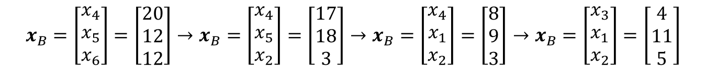
What was our Simplex Path?
$$x_{B}=\left[\begin{matrix}x_{4} \\ x_{5} \\ x_{6}\end{matrix}\right]=\left[\begin{matrix}20 \\ 12 \\ 12\end{matrix}\right]→x_{B}=\left[\begin{matrix}x_{4} \\ x_{5} \\ x_{2}\end{matrix}\right]=\left[\begin{matrix}17 \\ 18 \\ 3\end{matrix}\right]→x_{B}=\left[\begin{matrix}x_{4} \\ x_{1} \\ x_{2}\end{matrix}\right]=\left[\begin{matrix}8 \\ 9 \\ 3\end{matrix}\right]→x_{B}=\left[\begin{matrix}x_{3} \\ x_{1} \\ x_{2}\end{matrix}\right]=\left[\begin{matrix}4 \\ 11 \\ 5\end{matrix}\right]$$

Slide 16
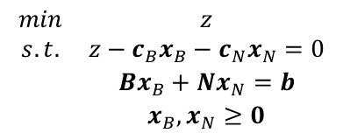
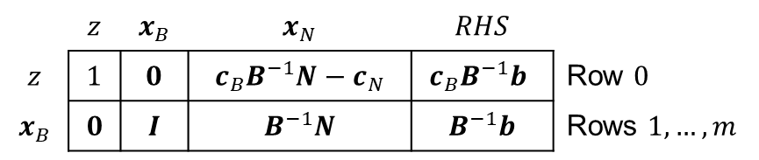
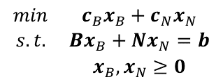
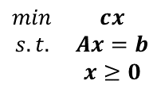
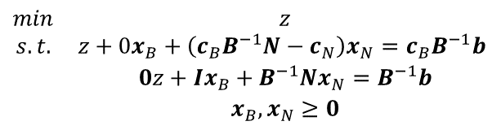


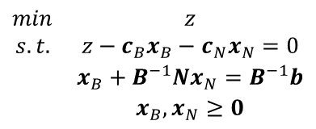
The Simplex Algorithm in Tableau Format (1 of 4)
$$\begin{matrix}min & z \\ s.t. & z−c_{B}x_{B}−c_{N}x_{N}=0 \\ & Bx_{B}+Nx_{N}=b \\ & x_{B},x_{N}≥0\end{matrix}$$
$$\begin{matrix}min & c_{B}x_{B}+c_{N}x_{N} \\ s.t. & Bx_{B}+Nx_{N}=b \\ & x_{B},x_{N}≥0\end{matrix}$$
$$\begin{matrix}min & cx \\ s.t. & Ax=b \\ & x≥0\end{matrix}$$
$$\begin{matrix}min & z \\ s.t. & z−c_{B}x_{B}−c_{N}x_{N}=0 \\ & x_{B}+B^{−1}Nx_{N}=B^{−1}b \\ & x_{B},x_{N}≥0\end{matrix}$$
Multiply by $c_{B}$
$$c_{B}x_{B}+c_{B}B^{−1}Nx_{N}=c_{B}B^{−1}b$$
Add to first constraint
$$\begin{matrix}min & z \\ s.t. & z+0x_{B}+\left(c_{B}B^{−1}N−c_{N}\right)x_{N}=c_{B}B^{−1}b \\ & 0z+Ix_{B}+B^{−1}Nx_{N}=B^{−1}b \\ & x_{B},x_{N}≥0\end{matrix}$$
 | $$z$$ | $$x_{B}$$ | $$x_{N}$$ | $$RHS$$
$$z$$ | $$1$$ | $$0$$ | $$c_{B}B^{−1}N−c_{N}$$ | $$c_{B}B^{−1}b$$ | Row $0$
$$x_{B}$$ | $$0$$ | $$I$$ | $$B^{−1}N$$ | $$B^{−1}b$$ | Rows $1,…,m$

Slide 17
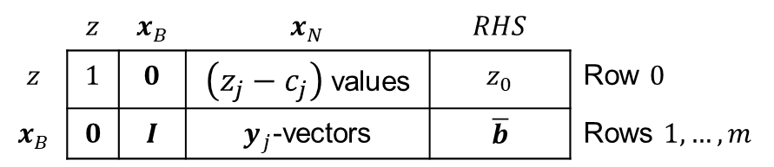
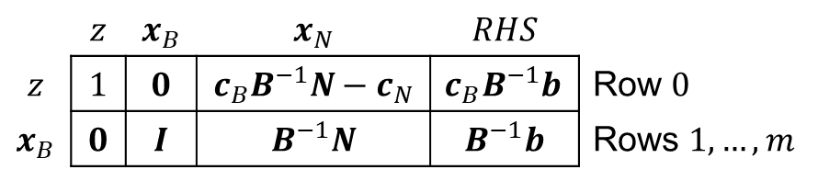
The Simplex Algorithm in Tableau Format (2 of 4)
 | $$z$$ | $$x_{B}$$ | $$x_{N}$$ | $$RHS$$
$$z$$ | $$1$$ | $$0$$ | $$c_{B}B^{−1}N−c_{N}$$ | $$c_{B}B^{−1}b$$ | Row $0$
$$x_{B}$$ | $$0$$ | $$I$$ | $$B^{−1}N$$ | $$B^{−1}b$$ | Rows $1,…,m$
 | $$z$$ | $$x_{B}$$ | $$x_{N}$$ | $$RHS$$
$$z$$ | $$1$$ | $$0$$ | $\left(z_{j}−c_{j}\right)$ values | $$z_{0}$$ | Row $0$
$$x_{B}$$ | $$0$$ | $$I$$ | $y_{j}$-vectors | $$\overline{b}$$ | Rows $1,…,m$

Slide 18
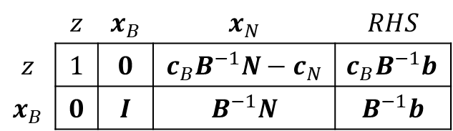
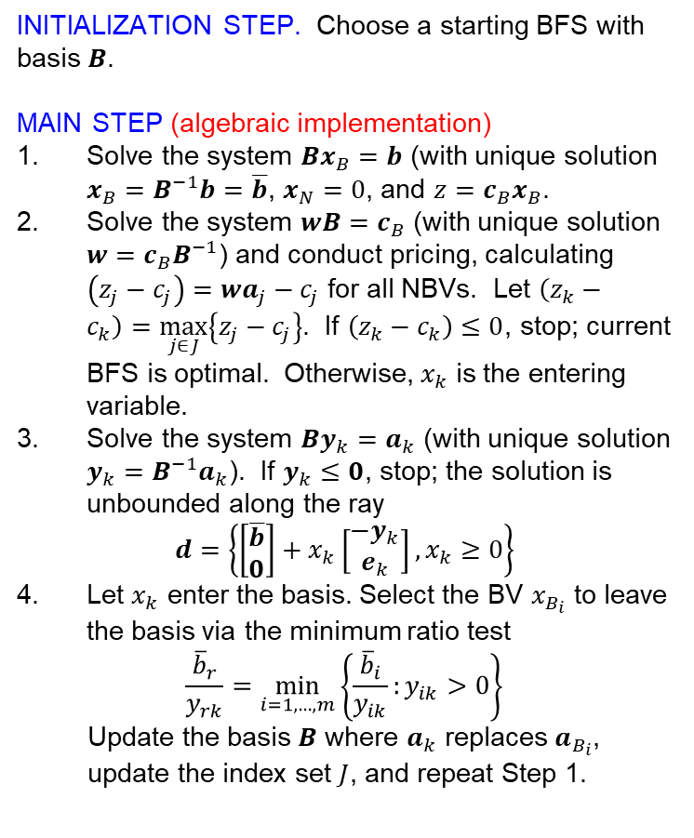
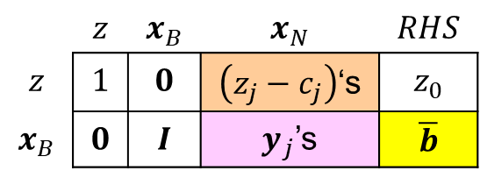
The Simplex Algorithm in Tableau Format (3 of 4)
INITIALIZATION STEP. Choose a starting BFS with basis $B$.
MAIN STEP (algebraic implementation)
Solve the system $Bx_{B}=b$ (with unique solution $x_{B}=B^{−1}b=\overline{b}$, $x_{N}=0$, and $z=c_{B}x_{B}$.
Solve the system $wB=c_{B}$ (with unique solution $w=c_{B}B^{−1}$) and conduct pricing, calculating $\left(z_{j}−c_{j}\right)=wa_{j}−c_{j}$ for all NBVs. Let $\left(z_{k}−c_{k}\right)=\max_{j∈J}\left\{z_{j}−c_{j}\right\}$. If $\left(z_{k}−c_{k}\right)≤0$, stop; current BFS is optimal. Otherwise, $x_{k}$ is the entering variable.
Solve the system $By_{k}=a_{k}$ (with unique solution $y_{k}=B^{−1}a_{k}$). If $y_{k}≤0$, stop; the solution is unbounded along the ray
$$d=\left\{\left[\begin{matrix}\overline{b} \\ 0\end{matrix}\right]+x_{k}\left[\begin{matrix}−y_{k} \\ e_{k}\end{matrix}\right],x_{k}≥0\right\}$$
Let $x_{k}$ enter the basis. Select the BV $x_{B_{i}}$ to leave the basis via the minimum ratio test
$$\frac{{\overline{b}}_{r}}{y_{rk}}=\min_{i=1,…,m}\left\{\frac{{\overline{b}}_{i}}{y_{ik}}:y_{ik}>0\right\}$$
Update the basis $B$ where $a_{k}$ replaces $a_{B_{i}}$, update the index set $J$, and repeat Step 1.
 | $$z$$ | $$x_{B}$$ | $$x_{N}$$ | $$RHS$$
$$z$$ | $$1$$ | $$0$$ | $$c_{B}B^{−1}N−c_{N}$$ | $$c_{B}B^{−1}b$$
$$x_{B}$$ | $$0$$ | $$I$$ | $$B^{−1}N$$ | $$B^{−1}b$$
 | $$z$$ | $$x_{B}$$ | $$x_{N}$$ | $$RHS$$
$$z$$ | $$1$$ | $$0$$ | $\left(z_{j}−c_{j}\right)$‘s | $$z_{0}$$
$$x_{B}$$ | $$0$$ | $$I$$ | $y_{j}$’s | $$\overline{b}$$
What efficiencies exist in the algebraic implementation of the Simplex Method?
What encumbrances exist?

Slide 19
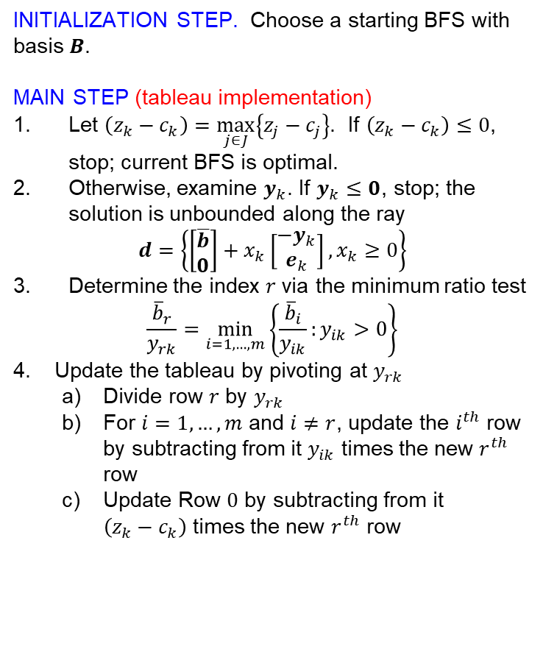
The Simplex Algorithm in Tableau Format (4 of 4)
INITIALIZATION STEP. Choose a starting BFS with basis $B$.
MAIN STEP (tableau implementation)
Let $\left(z_{k}−c_{k}\right)=\max_{j∈J}\left\{z_{j}−c_{j}\right\}$. If $\left(z_{k}−c_{k}\right)≤0$, stop; current BFS is optimal.
Otherwise, examine $y_{k}$. If $y_{k}≤0$, stop; the solution is unbounded along the ray
$$d=\left\{\left[\begin{matrix}\overline{b} \\ 0\end{matrix}\right]+x_{k}\left[\begin{matrix}−y_{k} \\ e_{k}\end{matrix}\right],x_{k}≥0\right\}$$
Determine the index $r$ via the minimum ratio test
$$\frac{{\overline{b}}_{r}}{y_{rk}}=\min_{i=1,…,m}\left\{\frac{{\overline{b}}_{i}}{y_{ik}}:y_{ik}>0\right\}$$
Update the tableau by pivoting at $y_{rk}$
Divide row $r$ by $y_{rk}$
For $i=1,…,m$ and $i≠r$, update the $i^{th}$ row by subtracting from it $y_{ik}$ times the new $r^{th}$ row
Update Row $0$ by subtracting from it $\left(z_{k}−c_{k}\right)$ times the new $r^{th}$ row
 | $$z$$ | $$x_{B}$$ | $$x_{N}$$ | $$RHS$$
$$z$$ | $$1$$ | $$0$$ | $$c_{B}B^{−1}N−c_{N}$$ | $$c_{B}B^{−1}b$$
$$x_{B}$$ | $$0$$ | $$I$$ | $$B^{−1}N$$ | $$B^{−1}b$$
 | $$z$$ | $$x_{B}$$ | $$x_{N}$$ | $$RHS$$
$$z$$ | $$1$$ | $$0$$ | $\left(z_{j}−c_{j}\right)$‘s | $$z_{0}$$
$$x_{B}$$ | $$0$$ | $$I$$ | $y_{j}$’s | $$\overline{b}$$
Does the tableau implementation improve upon the algebraic implementation?
If so, under what circumstances?
What challenges does it induce?

Slide 20
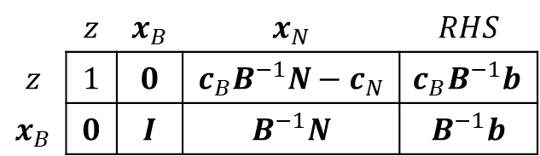
Example of the Simplex Algorithm in Tableau Format (Initialization)
Problem P
$$\begin{matrix}min & −2x_{1}−5x_{2}+x_{3} \\ s.t. & x_{1}+x_{2}+x_{3}+x_{4} =20 \\ & 2x_{1}−2x_{2} +x_{5} =12 \\ & 4x_{2}−2x_{3} +x_{6}=12 \\ & x_{1},x_{2},x_{3},x_{4},x_{5},x_{6}≥0\end{matrix}$$
INTIALIZATION STEP
 | z | x₁ | x₂ | x₃ | x₄ | x₅ | x₆ | RHS
z | 1 | 2 | 5 | -1 | 0 | 0 | 0 | 0
x₄ | 0 | 1 | 1 | 1 | 1 | 0 | 0 | 20
x₅ | 0 | 2 | -2 | 0 | 0 | 1 | 0 | 12
x₆ | 0 | 0 | 4 | -2 | 0 | 0 | 1 | 12
 | $$z$$ | $$x_{B}$$ | $$x_{N}$$ | $$RHS$$
$$z$$ | $$1$$ | $$0$$ | $$c_{B}B^{−1}N−c_{N}$$ | $$c_{B}B^{−1}b$$
$$x_{B}$$ | $$0$$ | $$I$$ | $$B^{−1}N$$ | $$B^{−1}b$$

Slide 21






Example of the Simplex Algorithm in Tableau Format (Iteration #1)
Step 1: $(z2−c2)=5$
$$\begin{matrix}min & −2x_{1}−5x_{2}+x_{3} \\ s.t. & x_{1}+x_{2}+x_{3}+x_{4} =20 \\ & 2x_{1}−2x_{2} +x_{5} =12 \\ & 4x_{2}−2x_{3} +x_{6}=12 \\ & x_{1},x_{2},x_{3},x_{4},x_{5},x_{6}≥0\end{matrix}$$
 | z | x₁ | x₂ | x₃ | x₄ | x₅ | x₆ | RHS
z | 1 | 2 | 5 | -1 | 0 | 0 | 0 | 0
x₄ | 0 | 1 | 1 | 1 | 1 | 0 | 0 | 20
x₅ | 0 | 2 | -2 | 0 | 0 | 1 | 0 | 12
x₆ | 0 | 0 | 4 | -2 | 0 | 0 | 1 | 12
INITIALIZATION STEP. Choose a starting BFS with basis $B$.
MAIN STEP (tableau implementation)
Let $\left(z_{k}−c_{k}\right)=\max_{j∈J}\left\{z_{j}−c_{j}\right\}$. If $\left(z_{k}−c_{k}\right)≤0$, stop; current BFS is optimal.
Otherwise, examine $y_{k}$. If $y_{k}≤0$, stop; the solution is unbounded along the ray
$$d=\left\{\left[\begin{matrix}\overline{b} \\ 0\end{matrix}\right]+x_{k}\left[\begin{matrix}−y_{k} \\ e_{k}\end{matrix}\right],x_{k}≥0\right\}$$
Determine the index $r$ via the minimum ratio test
$$\frac{{\overline{b}}_{r}}{y_{rk}}=\min_{i=1,…,m}\left\{\frac{{\overline{b}}_{i}}{y_{ik}}:y_{ik}>0\right\}$$
Update the tableau by pivoting at $y_{rk}$
Divide row $r$ by $y_{rk}$
For $i=1,…,m$ and $i≠r$, update the $i^{th}$ row by subtracting from it $y_{ik}$ times the new $r^{th}$ row
Update Row $0$ by subtracting from it $\left(z_{k}−c_{k}\right)$ times the new $r^{th}$ row
Step 2: OK; we don’t have $y20$.
Step 3: Min ratio is 3. The blocking variable is $x6.$
Step 4
 | z | x₁ | x₂ | x₃ | x₄ | x₅ | x₆ | RHS
z | 1 | 2 | 0 | 3/2 | 0 | 0 | -5/4 | -15
x₄ | 0 | 1 | 0 | 3/2 | 1 | 0 | -1/4 | 17
x₅ | 0 | 2 | 0 | -1 | 0 | 1 | 1/2 | 18
x₂ | 0 | 0 | 1 | -1/2 | 0 | 0 | 1/4 | 3
$$z=z_{0}−\left(z_{2}−c_{2}\right)x_{k}$$
$$x_{B}=\overline{b}−y_{k}x_{k}$$

Slide 22


Example of the Simplex Algorithm in Tableau Format (Iteration #2)
Step 1: $(z1−c1)=5$
$$\begin{matrix}min & −2x_{1}−5x_{2}+x_{3} \\ s.t. & x_{1}+x_{2}+x_{3}+x_{4} =20 \\ & 2x_{1}−2x_{2} +x_{5} =12 \\ & 4x_{2}−2x_{3} +x_{6}=12 \\ & x_{1},x_{2},x_{3},x_{4},x_{5},x_{6}≥0\end{matrix}$$
 | z | x₁ | x₂ | x₃ | x₄ | x₅ | x₆ | RHS
z | 1 | 2 | 0 | 3/2 | 0 | 0 | -5/4 | -15
x₄ | 0 | 1 | 0 | 3/2 | 1 | 0 | -1/4 | 17
x₅ | 0 | 2 | 0 | -1 | 0 | 1 | 1/2 | 18
x₂ | 0 | 0 | 1 | -1/2 | 0 | 0 | 1/4 | 3
INITIALIZATION STEP. Choose a starting BFS with basis $B$.
MAIN STEP (tableau implementation)
Let $\left(z_{k}−c_{k}\right)=\max_{j∈J}\left\{z_{j}−c_{j}\right\}$. If $\left(z_{k}−c_{k}\right)≤0$, stop; current BFS is optimal.
Otherwise, examine $y_{k}$. If $y_{k}≤0$, stop; the solution is unbounded along the ray
$$d=\left\{\left[\begin{matrix}\overline{b} \\ 0\end{matrix}\right]+x_{k}\left[\begin{matrix}−y_{k} \\ e_{k}\end{matrix}\right],x_{k}≥0\right\}$$
Determine the index $r$ via the minimum ratio test
$$\frac{{\overline{b}}_{r}}{y_{rk}}=\min_{i=1,…,m}\left\{\frac{{\overline{b}}_{i}}{y_{ik}}:y_{ik}>0\right\}$$
Update the tableau by pivoting at $y_{rk}$
Divide row $r$ by $y_{rk}$
For $i=1,…,m$ and $i≠r$, update the $i^{th}$ row by subtracting from it $y_{ik}$ times the new $r^{th}$ row
Update Row $0$ by subtracting from it $\left(z_{k}−c_{k}\right)$ times the new $r^{th}$ row
Step 2: OK; we don’t have $yk0$.
Step 3: Min ratio is 9. The blocking variable is $x5$.
Step 4
 | z | x₁ | x₂ | x₃ | x₄ | x₅ | x₆ | RHS
z | 1 | 0 | 0 | 5/2 | 0 | -1 | -7/4 | -33
x₄ | 0 | 0 | 0 | 2 | 1 | -1/2 | -1/2 | 8
x₁ | 0 | 1 | 0 | -1/2 | 0 | 1/2 | 1/4 | 9
x₂ | 0 | 0 | 1 | -1/2 | 0 | 0 | 1/4 | 3

Slide 23

Example of the Simplex Algorithm in Tableau Format (Iteration #3)
Step 1: $(z3−c3)=2.5$
$$\begin{matrix}min & −2x_{1}−5x_{2}+x_{3} \\ s.t. & x_{1}+x_{2}+x_{3}+x_{4} =20 \\ & 2x_{1}−2x_{2} +x_{5} =12 \\ & 4x_{2}−2x_{3} +x_{6}=12 \\ & x_{1},x_{2},x_{3},x_{4},x_{5},x_{6}≥0\end{matrix}$$
 | z | x₁ | x₂ | x₃ | x₄ | x₅ | x₆ | RHS
z | 1 | 0 | 0 | 5/2 | 0 | -1 | -7/4 | -33
x₄ | 0 | 0 | 0 | 2 | 1 | -1/2 | -1/2 | 8
x₁ | 0 | 1 | 0 | -1/2 | 0 | 1/2 | 1/4 | 9
x₂ | 0 | 0 | 1 | -1/2 | 0 | 0 | 1/4 | 3
INITIALIZATION STEP. Choose a starting BFS with basis $B$.
MAIN STEP (tableau implementation)
Let $\left(z_{k}−c_{k}\right)=\max_{j∈J}\left\{z_{j}−c_{j}\right\}$. If $\left(z_{k}−c_{k}\right)≤0$, stop; current BFS is optimal.
Otherwise, examine $y_{k}$. If $y_{k}≤0$, stop; the solution is unbounded along the ray
$$d=\left\{\left[\begin{matrix}\overline{b} \\ 0\end{matrix}\right]+x_{k}\left[\begin{matrix}−y_{k} \\ e_{k}\end{matrix}\right],x_{k}≥0\right\}$$
Determine the index $r$ via the minimum ratio test
$$\frac{{\overline{b}}_{r}}{y_{rk}}=\min_{i=1,…,m}\left\{\frac{{\overline{b}}_{i}}{y_{ik}}:y_{ik}>0\right\}$$
Update the tableau by pivoting at $y_{rk}$
Divide row $r$ by $y_{rk}$
For $i=1,…,m$ and $i≠r$, update the $i^{th}$ row by subtracting from it $y_{ik}$ times the new $r^{th}$ row
Update Row $0$ by subtracting from it $\left(z_{k}−c_{k}\right)$ times the new $r^{th}$ row
Step 2: OK; we don’t have $yk0$.
Step 3: Min ratio is 4. The blocking variable is $x4$.
Step 4
 | z | x₁ | x₂ | x₃ | x₄ | x₅ | x₆ | RHS
z | 1 | 0 | 0 | 0 | -5/4 | -3/8 | -9/8 | -43
x₃ | 0 | 0 | 0 | 1 | 1/2 | -1/4 | -1/4 | 4
x₁ | 0 | 1 | 0 | 0 | 1/4 | 3/8 | 1/8 | 11
x₂ | 0 | 0 | 1 | 0 | 1/4 | -1/8 | 1/8 | 5
Terminate the algorithm! The BFS is optimal! (Why?)

Slide 24
The Simplex via Tableau
Robert Vanderbei’s online tool
https://vanderbei.princeton.edu/JAVA/pivot/simple.html
Simplex Me online tool
www.simplexme.com

Slide 25

Questions
Why not just start with a feasible solution and move in an improving direction?
Won’t this get you to an optimal solution?
Won’t it get you to a point for using the Simplex Method from there on?
$$\begin{matrix}min & −2x_{1}−5x_{2}+x_{3} \\ s.t. & x_{1}+x_{2}+x_{3}+x_{4} =20 \\ & 2x_{1}−2x_{2} +x_{5} =12 \\ & 4x_{2}−2x_{3} +x_{6}=12 \\ & x_{1},x_{2},x_{3},x_{4},x_{5},x_{6}≥0\end{matrix}$$

Slide 26

Computational Complexity of the Simplex Algorithm (Tableau Format)
Operations per iteration → occur during pricing
Multiplications $(m+1)(n−m+1)$
Additions $m(n−m+1)$
Result: $O(mn)$
Number of iterations
Practical experience: m to 3m iterations
Better bounds possible when considering sparsity of A
Worst-case are obtainable, and pretty bad… (will discuss later)
Average empirical complexity → $O(m2n)$

Slide 27
Questions & Discussion

Slide 28
For Next Class
Sections 4.1-4.6
Homework #5: Problem 1.13 (Phase 1)
First, write an explicit formulation
Define sets, parameters, DVs, assumptions!
Second, use set-based notation and indexing of DVs and constraints to present a compact formulation

